Slide 1
BOOSTING
Boosting is an ensemble learning method that combines a set of weak learners into a strong learner to minimize training errors. In boosting, a random sample of data is selected, fitted with a model and then trained sequentially—that is, each model tries to compensate for the weaknesses of its predecessor.
In machine learning, boosting is an ensemble meta-algorithm for primarily reducing bias, and also variance in supervised learning, and a family of machine learning algorithms that convert weak learners to strong ones.

Slide 2
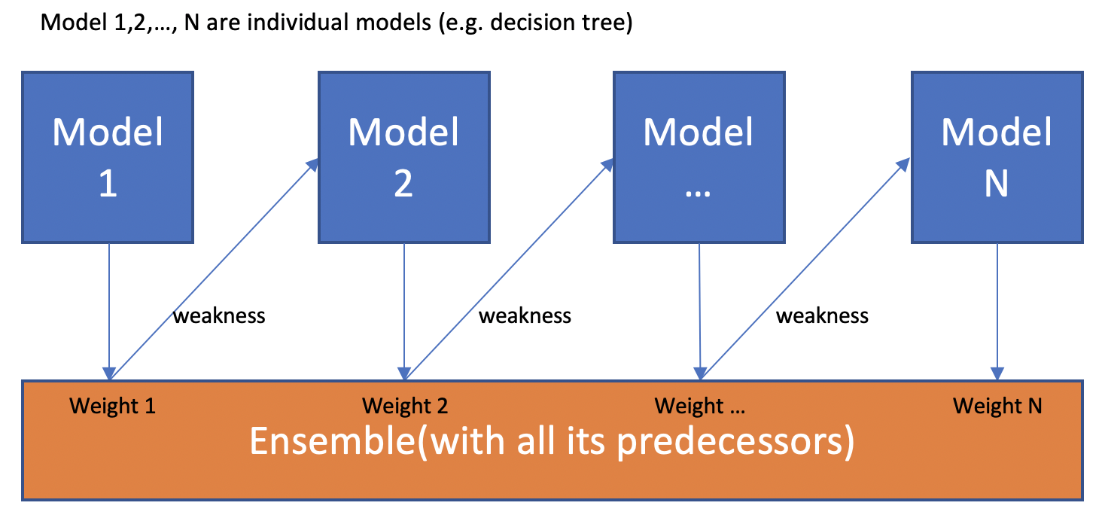
What is boosting used for? The term 'Boosting' refers to a family of algorithms which converts weak learner to strong learners. Boosting is an ensemble method for improving the model predictions of any given learning algorithm.

Slide 3
There are three types of Boosting Algorithms which are as follows: AdaBoost (Adaptive Boosting) algorithm. Gradient Boosting algorithm. XG Boost algorithm.
AdaBoost algorithm, short for Adaptive Boosting, is a Boosting technique used as an Ensemble Method in Machine Learning. It is called Adaptive Boosting as the weights are re-assigned to each instance, with higher weights assigned to incorrectly classified instances.
How does AdaBoost work?
AdaBoost (Adaptive Boosting) : It works on similar method as discussed above. It fits a sequence of weak learners on different weighted training data. ... If prediction is incorrect using the first learner, then it gives higher weight to observation which have been predicted incorrectly

Slide 4
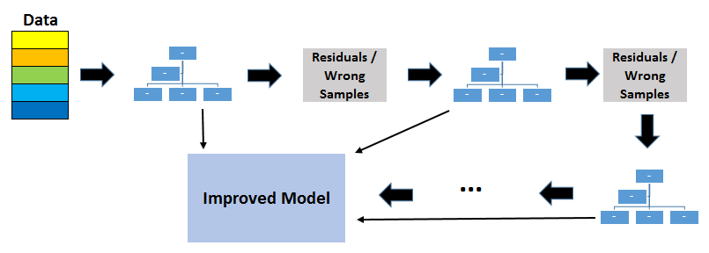
Gradient boosting is a machine learning technique for regression, classification and other tasks, which produces a prediction model in the form of an ensemble of weak prediction models, typically decision trees. Gradient boosting is a type of machine learning boosting. It relies on the intuition that the best possible next model, when combined with previous models, minimizes the overall prediction error. The key idea is to set the target outcomes for this next model in order to minimize the error.

Slide 5
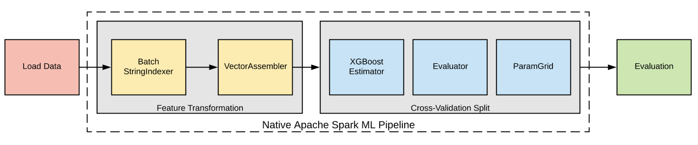
XGBoost is an algorithm that has recently been dominating applied machine learning and Kaggle competitions for structured or tabular data. XGBoost is an implementation of gradient boosted decision trees designed for speed and performance. XGBoost is used in supervised learning(regression and classification problems). Supports parallel processing. Cache optimization. Efficient memory management for large datasets exceeding RAM.

Slide 6
Difference Between
AdaBoost is the first designed boosting algorithm with a particular loss function. On the other hand, Gradient Boosting is a generic algorithm that assists in searching the approximate solutions to the additive modelling problem. This makes Gradient Boosting more flexible than AdaBoost.
XGBoost was developed to increase speed and performance, while introducing regularization parameters to reduce overfitting. Gradient boosted trees use regression trees (or CART) in a sequential learning process as weak learners.

